Slide 1


AI CAREER ROADMAP
THE FUTURE OF CAREER GUIDANCE
CREATED BY ;
Biswajita Pati ,
Sania Suhani Nayak
LIVE PROJECT
-Computer Engineering & IoT
-5th Sem
-Govt. Polytechnic Bhubaneswar

Slide 2





Project Introduction
AI-Powered Guidance
Personalized Roadmaps
Google Gemini AI Engine
"Helping students plan their future with confidence through smart career intelligence."

Slide 3



Problem & Solution
THE GAP
THE BRIDGE
Career Confusion
AI Career Roadmap
No Proper Roadmap
Personalized Paths
Skill Selection Issues
Learning Resources
Lack of Guidance
Skill Recommendations
Salary Uncertainty
Career Prep Support

Slide 4













Technologies Used
FRONTEND
BACKEND/AI
UX/TOOLS
React 19
TanStack
Framer
TypeScript
Gemini AI
Query
Tailwind
Gateway
Export
Vite
Zod
Responsive

Slide 5










Working Process
1
2
3
User Input
Request Sent
AI Generation
Enter career name into search.
Securely sent to AI backend.
Gemini AI creates roadmap.
4
5
6
Validation
Display
Download
Zod ensures data accuracy.
Roadmap rendered visually.
Export for offline access.
PDF
Markdown
JSON

Slide 6










Main Features
Career Overview
Personalized Roadmap
Skills Analysis
Tools Recommendation
Learning Resources
Project Suggestions
Internship & Interview Prep
Salary Info (INR)
AI Career Coach Advice

Slide 7



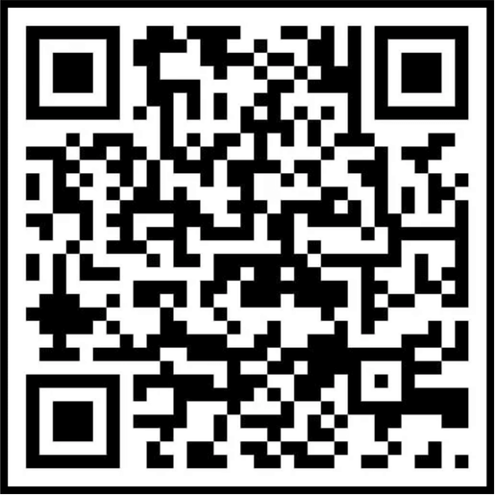



Live Project Demo
Search any career
ai-career-roadmapp-sanbis.lovable.app
AI generates roadmap
View skills & resources
Check salary data
Download roadmap
SCAN TO VISIT

Slide 8







Future Scope
User Accounts
Progress Tracking
Mobile App
"Helping students make informed career decisions through AI-powered guidance."
Community
Mentor Matching
Job Board
Created By:Biswajita Pati
Sania Suhani Nayak

